Slide 1
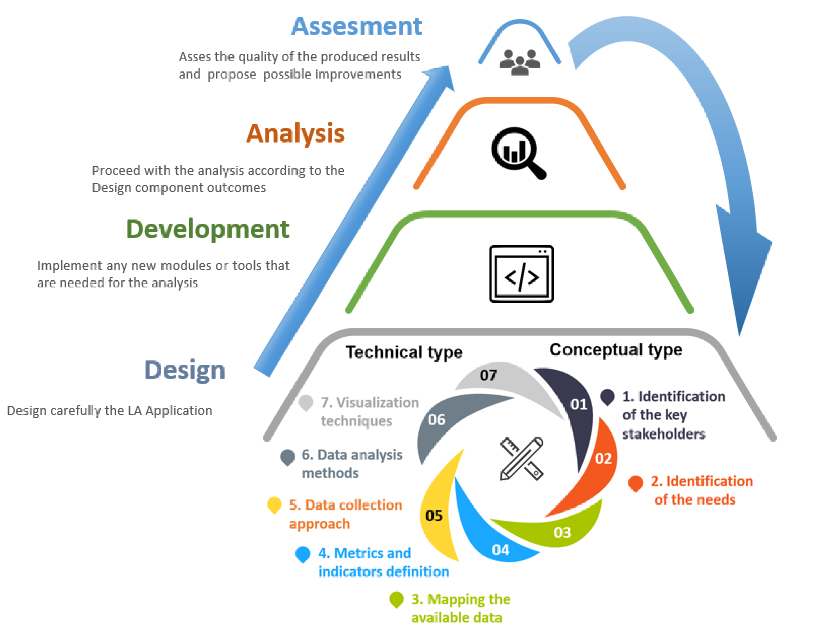
Outputs and visualization (in app)
PBI/other
Interim prototype implementation
Full Brewdat implementation
Analytics Playground brain
Azure Synapse (SQL Data Warehouse) (if more speed required)
Delta Lake (silver)
Data transformation and pre-processing
Sensitive data obfuscation
Sensitive data obfuscation
Automated File/s
ABI Azure File Share (External/Internal)
Delta Lake (bronze)
Knowledge graph/semantic layer
Other sources (GCP)
Source Systems
Brewdat ingestion (no replication)
Syspro
Commercial/logistics/finance/other
E-commerce

Slide 2








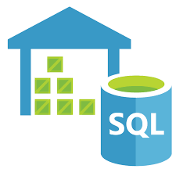
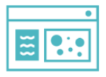




Real Time Architecture (WIP)
INGEST
PROCESS & STORE
SERVE
=
Real Time Applications
Logs, files and media
(unstructured)
Logs, files and media
(unstructured)
BRONZE (LZ)
SILVER (HZ)
GOLD (TZ)
SECURITY
IoT Hub
SPEED LAYER
.
.
AI & ML
.
.
Sensors
and IoT
(unstructured)
Sensors and IoT
(unstructured)
Raw Ingestion
Filtered,
Cleansed
Augmented
Azure SQL
Data Warehouse
BI and Analytics
Aggregations
BATCH LAYER
Batch Data
(Apps, logs)
Batch Data
(Apps, logs)
AI & ML
BASE
Power BI
DBFS
Mount
Storage (ADLS)

